Slide 1

Project 1: Investment Portfolio
Benjamin Kalnbach

Slide 2
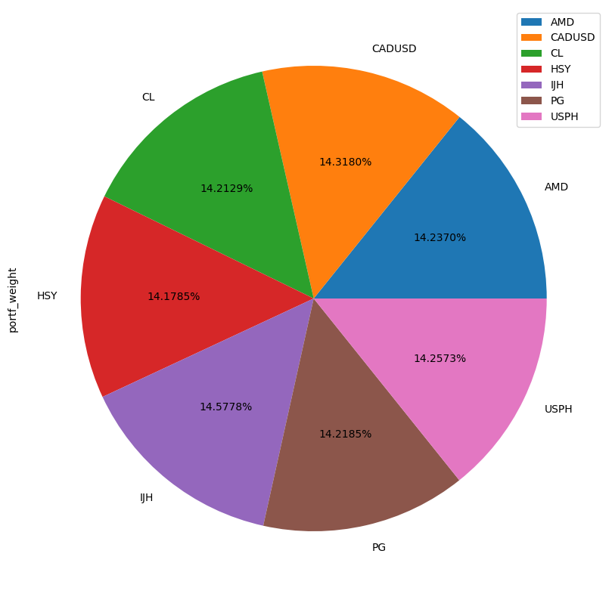
Investment Choices
Stocks:
AMD – Advanced Micro Devices
Stock has been sharply rising over the last 5 years
CL – Colgate-Palmolive Company
Low volatility, steady growth
HSY – The Hershey Company
Historically steady growth, diversification
PG – The Procter & Gamble Company
Incredibly steady growth
USPH – U.S. Physical Therapy, Inc.
Diversification

Slide 3
Investment Choices Cont.
ETF:
IJH – iShares Core S&P Mid-Cap ETF
Further diversification in the make up the fund
Top Three Sectors: Industrials, Financial Services, and Consumer Cyclical
FOREX
CADUSD
Buy low, sell high

Slide 4



Ingestion Process - ELT
Extract data from Polygon.io using Python
Load into MS SQL Server
Transform data in MS SQL Server

Slide 5
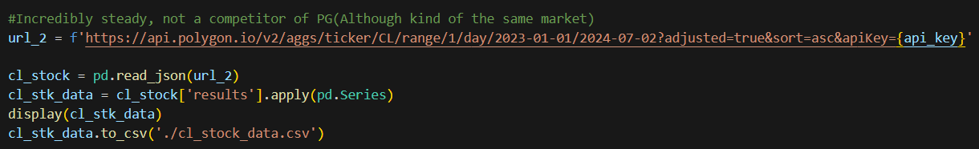
Extract
Query Polygon.io and turn the ‘results’ column into DataFrame
Save result as .csv

Slide 6
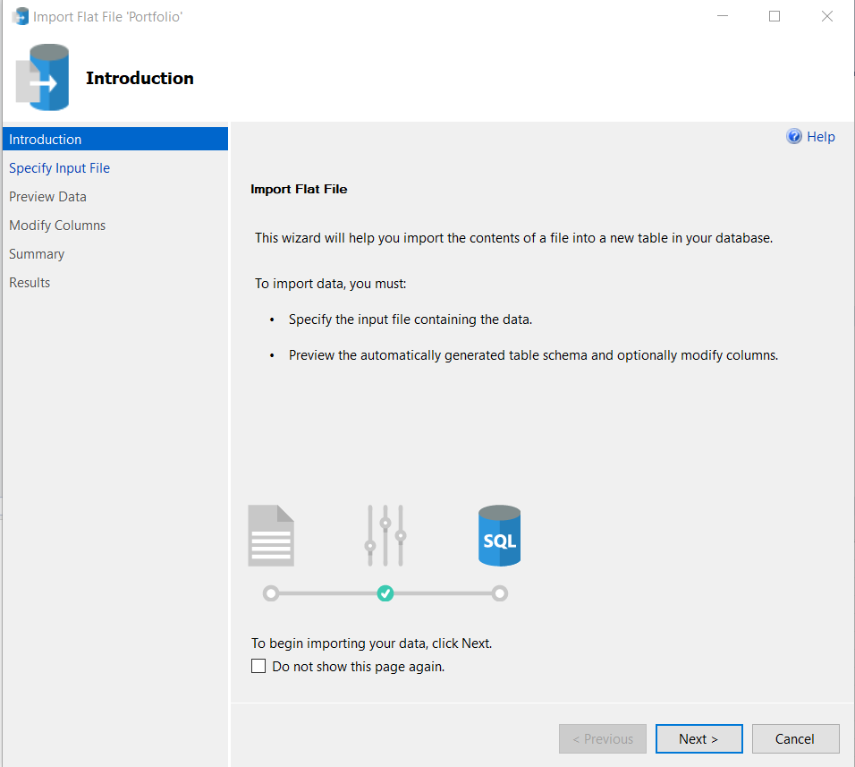
Load
Create new database in SQL
Right click new DB in Object Explorer, in “Tasks” drop down select Import “Flat File…”
Use wizard to import as new table within database

Slide 7
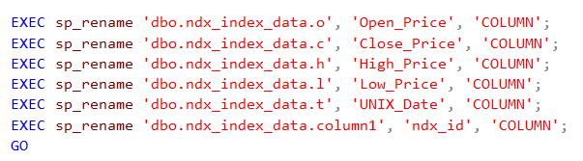
Transform
Transform semi-usable data into easily used data
Rename columns
Convert UNIX time to DateTime, fix FOREX dates
Create Star Schema
Aggregate Dimension Tables into Fact Table

Slide 8
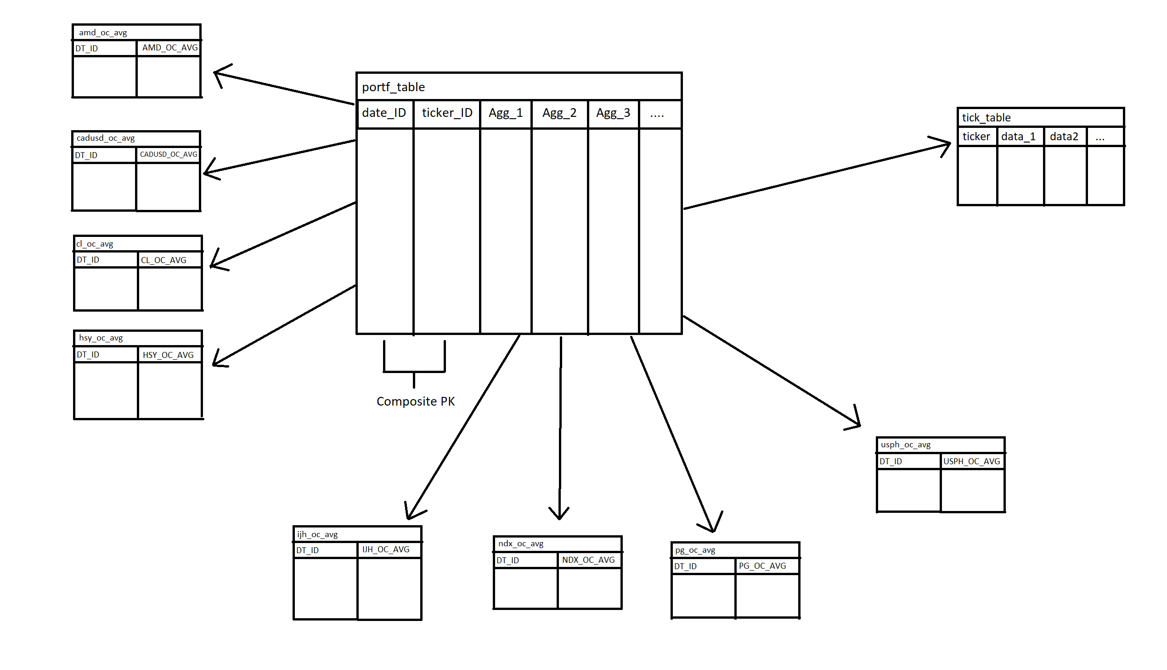
Star Schema

Slide 9
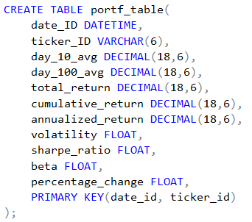
Aggregations
10 Day Average
100 Day Average
Total, Cumulative, Annualized Returns
Volatility
Sharpe Ratio
Beta
Percent Change

Slide 10
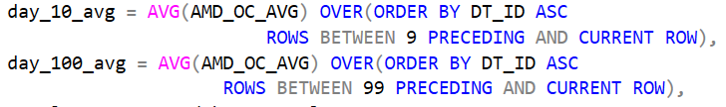
10 & 100 Day Average
Simple Calculation
Just AVG() aggregation over the N-1 preceding days and the current day

Slide 11
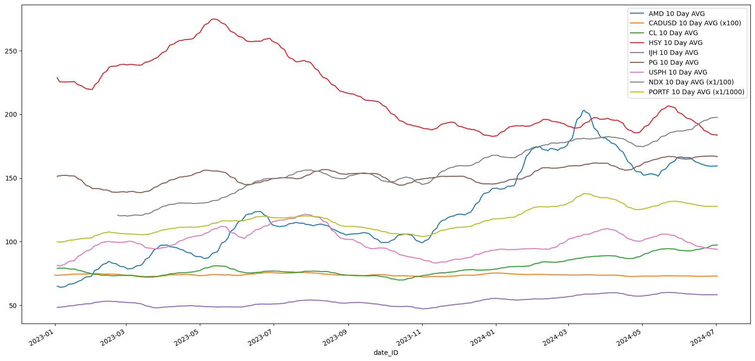
10 Day Average - Results

Slide 12
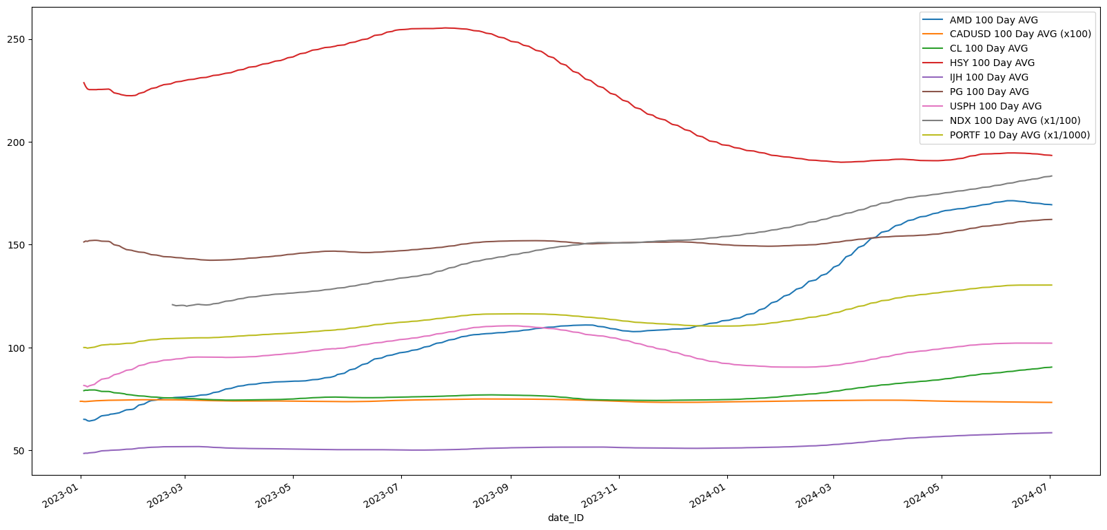
100 Day Average - Results

Slide 13
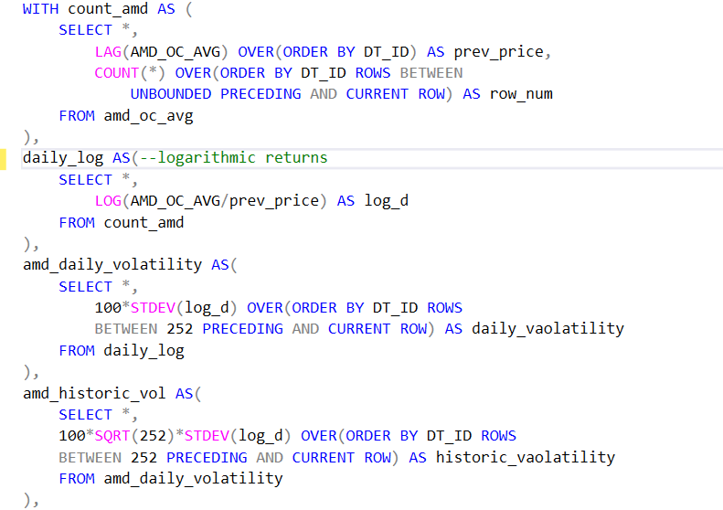
Percent Change & Volatility
Two ways to visualize the same thing
VS

Slide 14
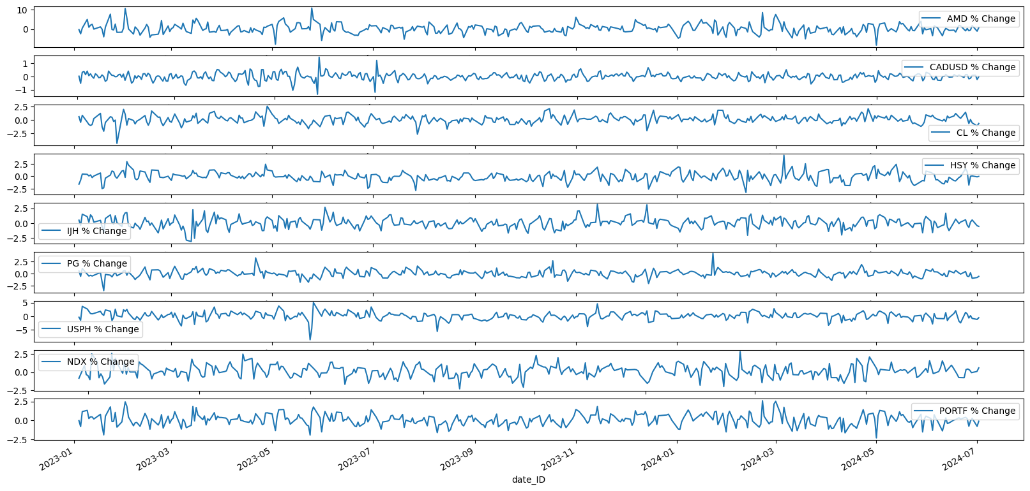
Percent Change - Results

Slide 15
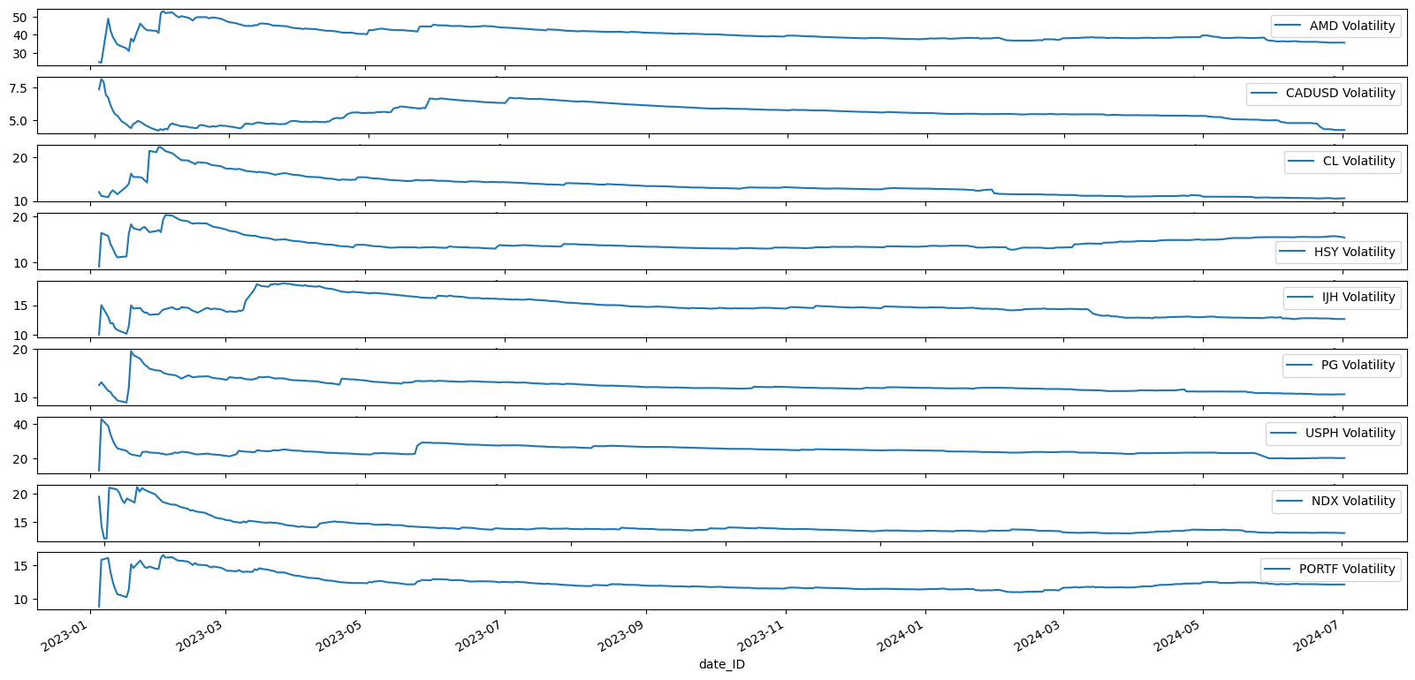
Volatility - Results

Slide 16
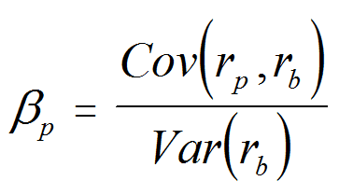
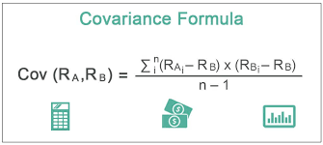
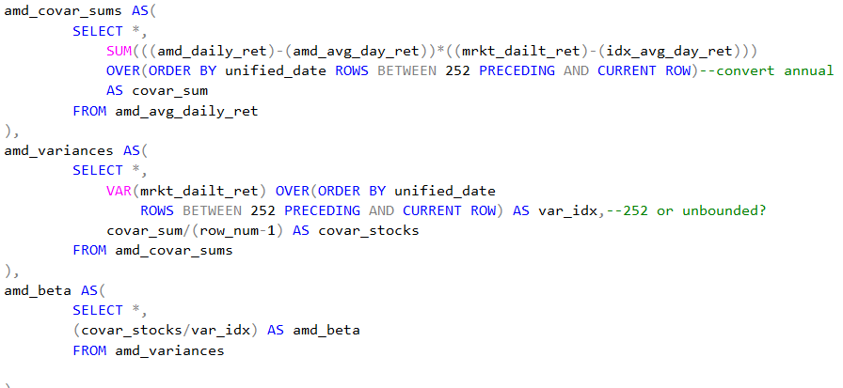
Beta
Lengthy process in SQL
Need both Covariance and Variance Aggregations
MS SQL provides Variance function… but no Covariance

Slide 17
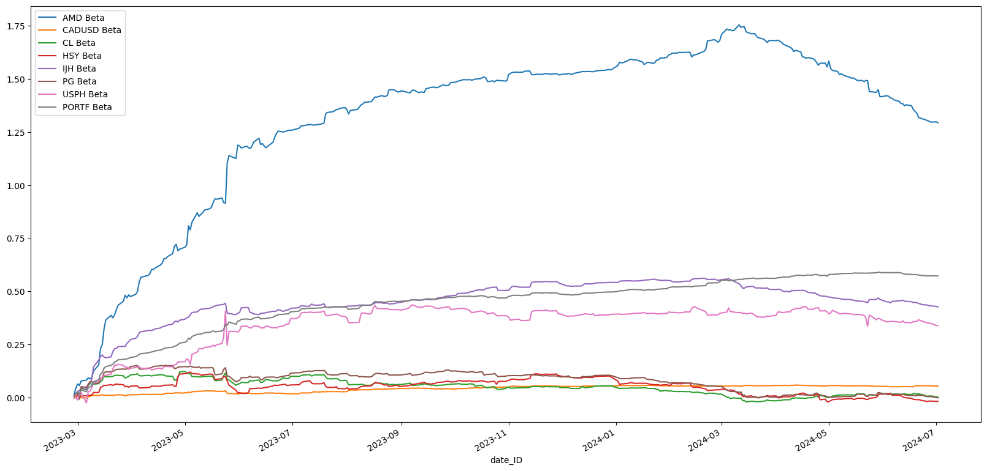
Beta - Results

Slide 18
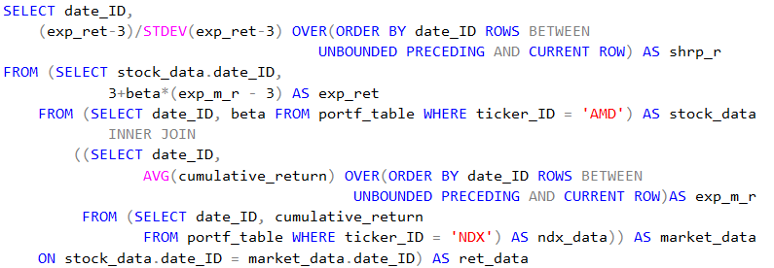
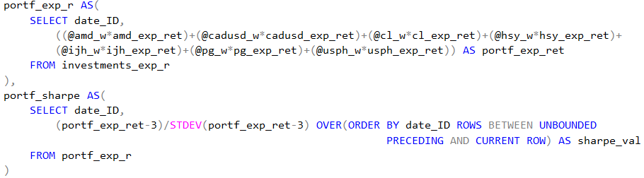
Sharpe Ratio
Single Stock:
Portfolio:

Slide 19
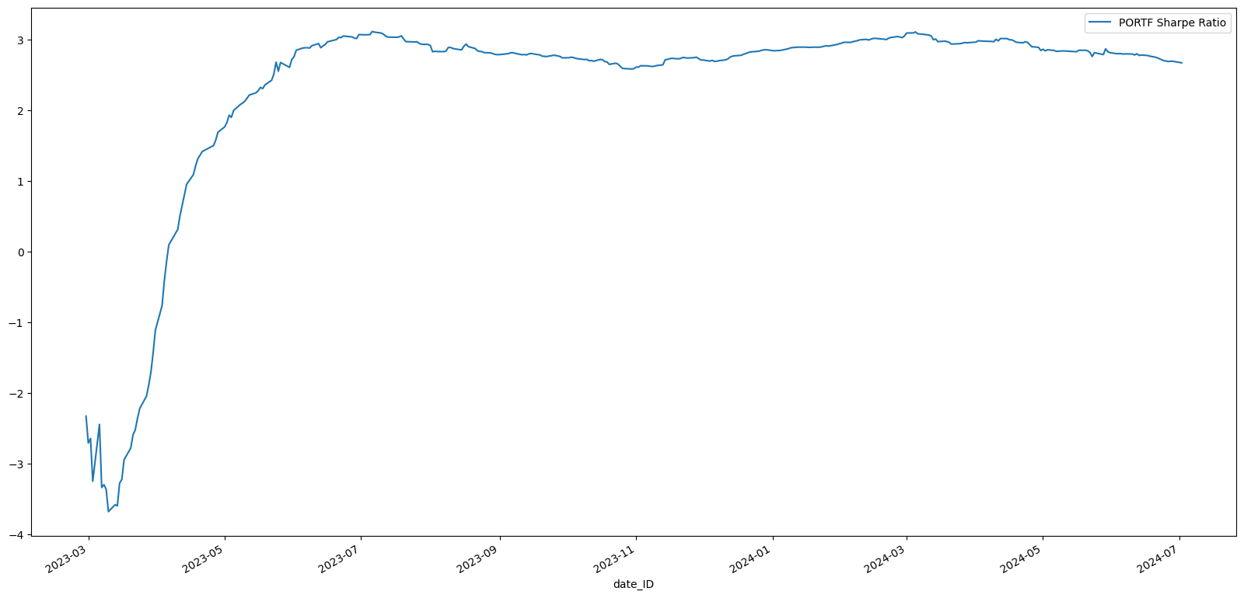
Sharpe Ratio – Results: Portfolio

Slide 20
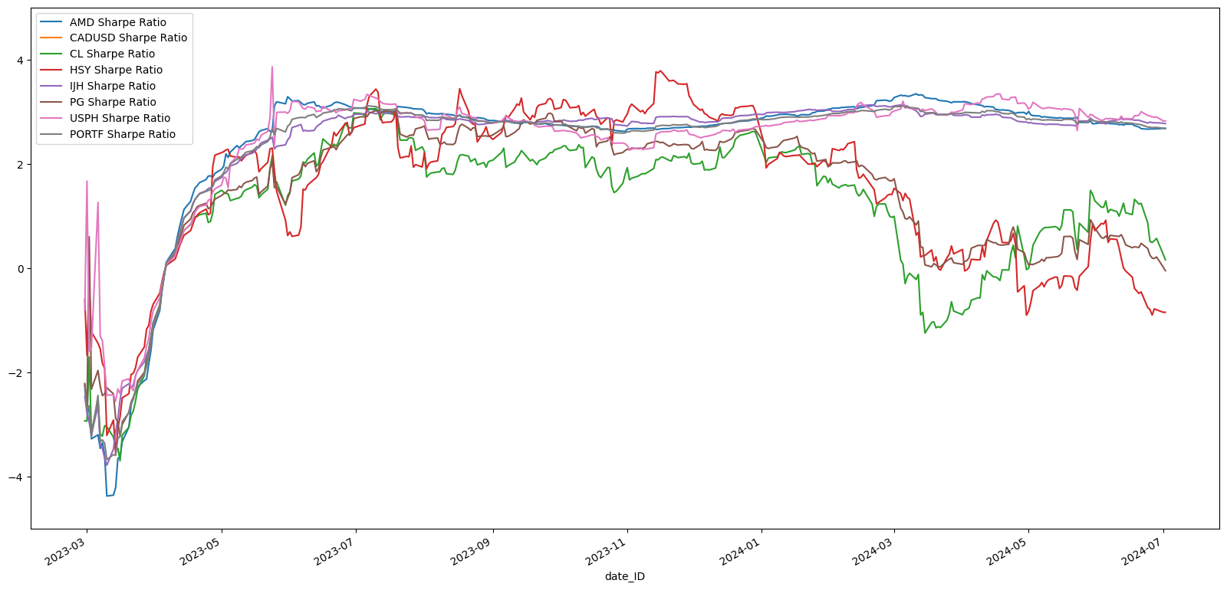
Sharpe Ratio – Results [ALL]

Slide 21
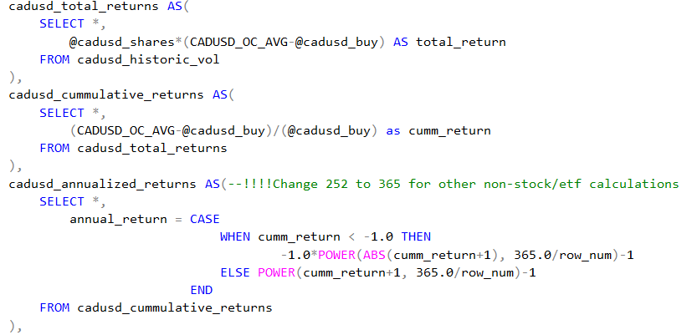
Returns
More Simple Aggregations

Slide 22
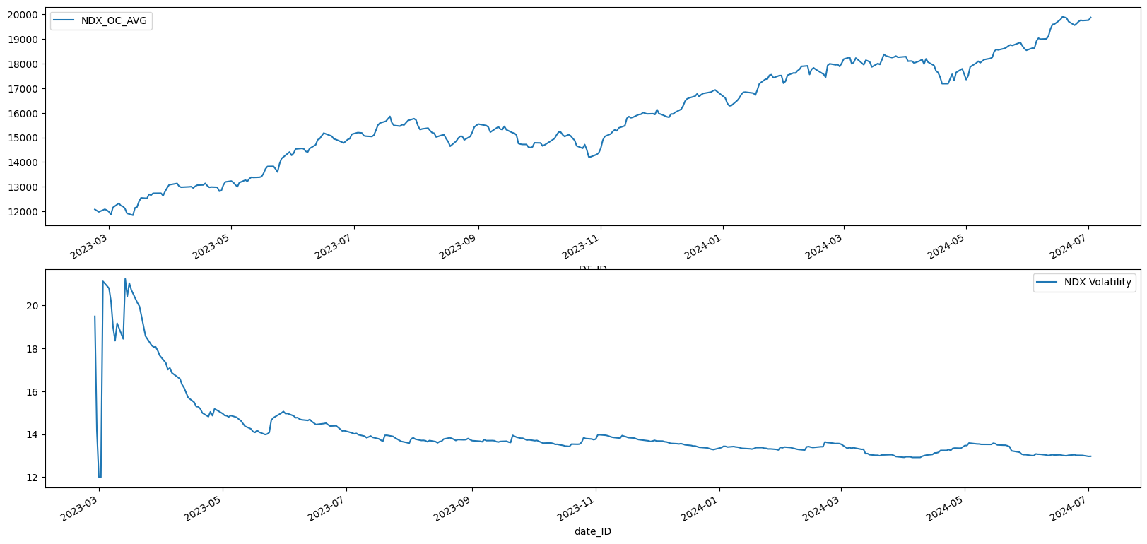
Market Index - NDX

Slide 23
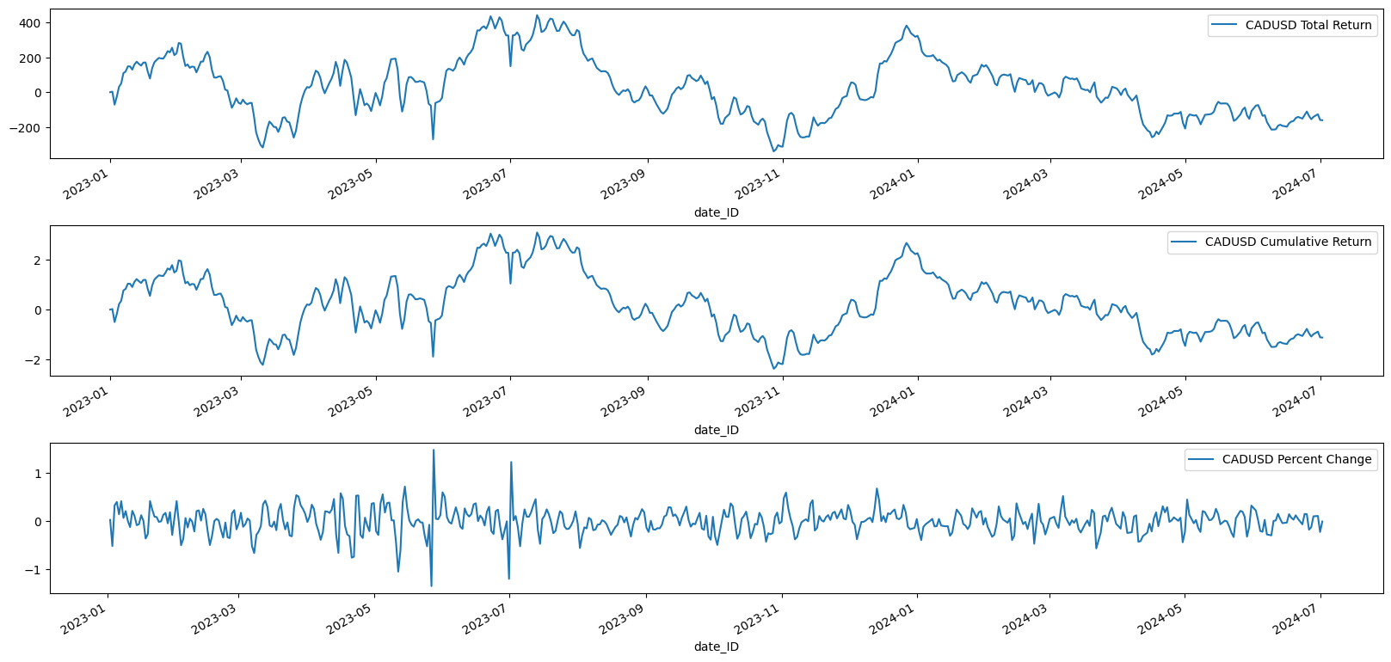
FOREX - CADUSD

Slide 24
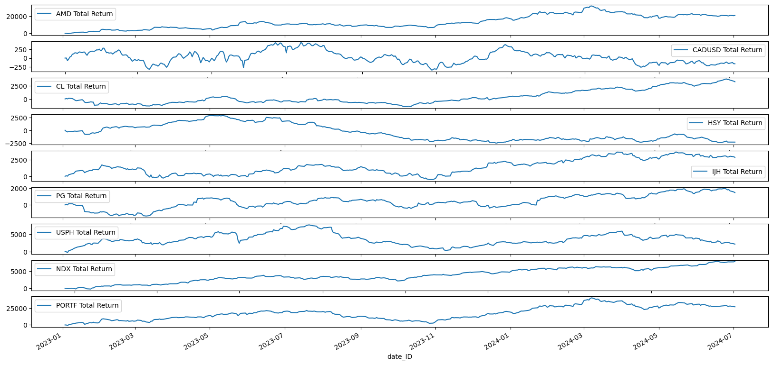
Total Returns

Slide 25
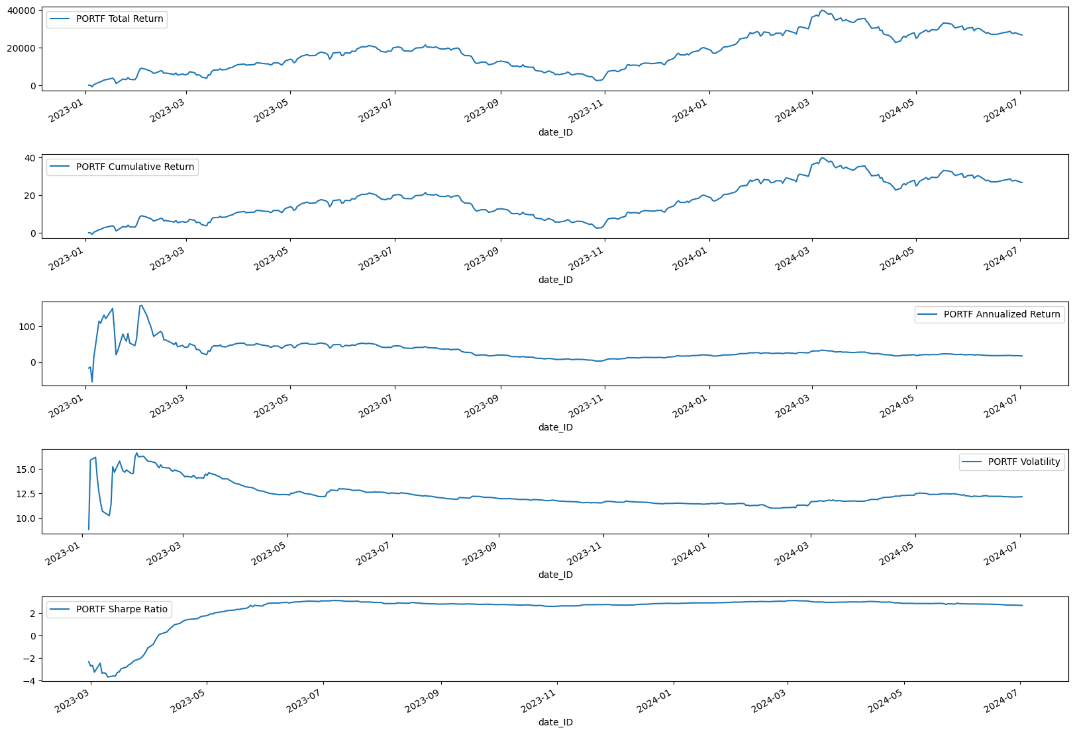

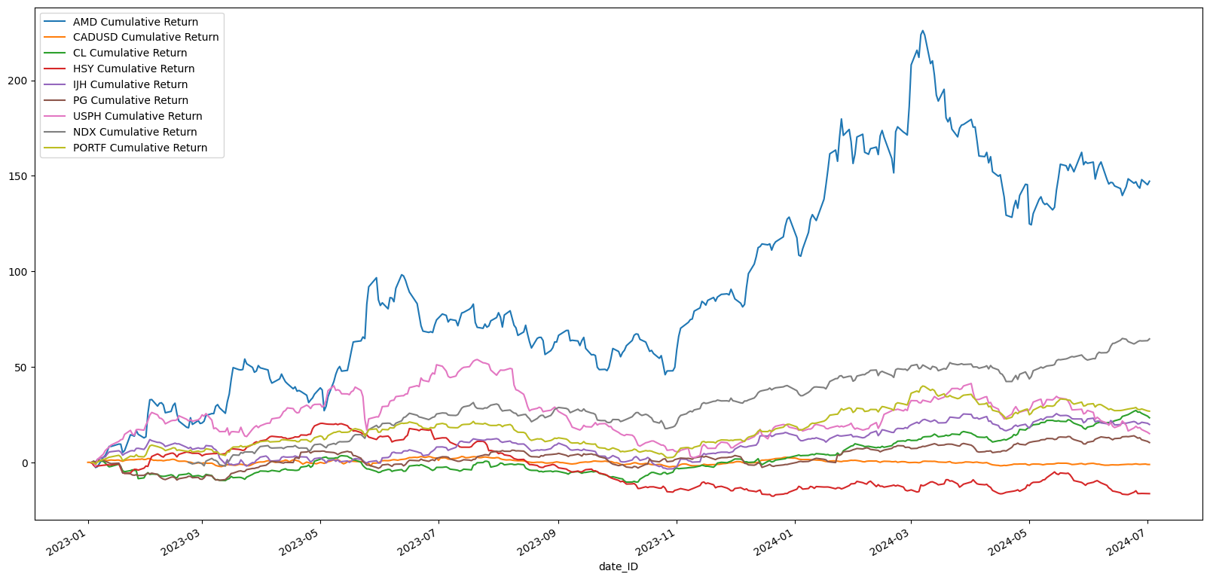
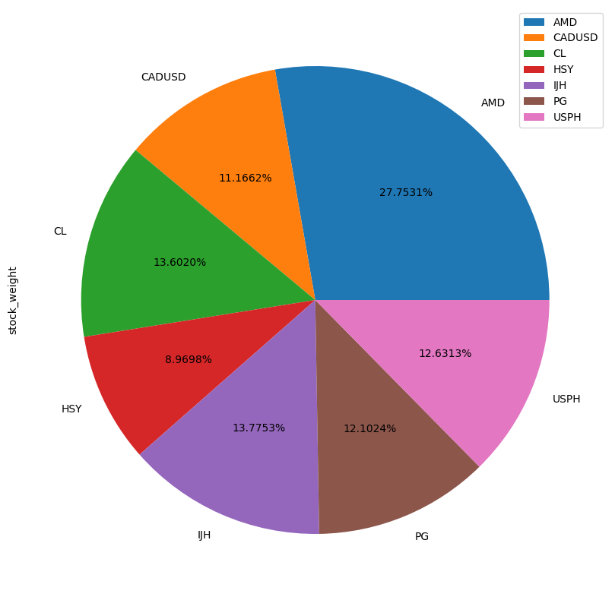
Dashboard

